Slide 1


Developing a Professional and Corporate Image in a Competitive World
Henry Quesada
Assistant Professor, Virginia Tech
San José, Costa Rica
August 2013

Slide 2

We live in a very competitive World
http://incisivestrategies.com/services.php

Slide 3
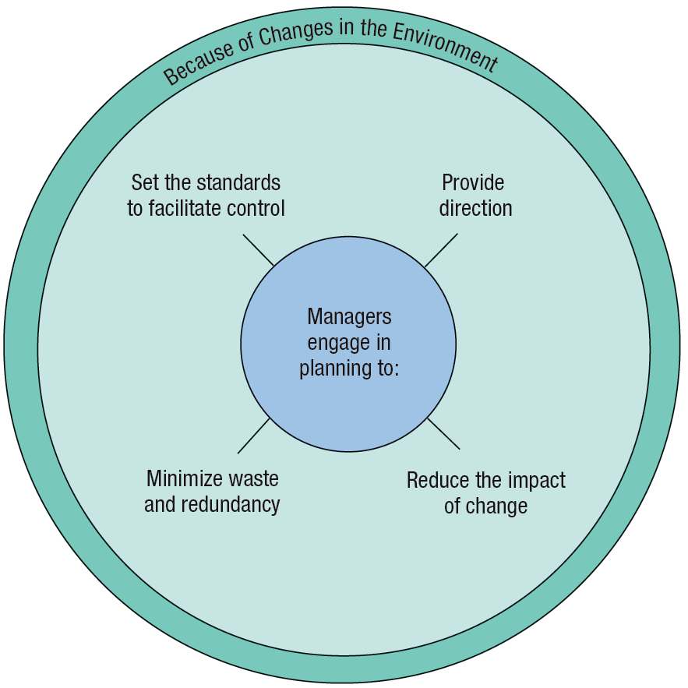
What do firms prepare?
Robbins, DeCenzo. 2010. Fundamentals of Management. 6th edition. Pearson Prentice Hall

Slide 4
Corporate Image (CI)
Represents the impressions and associations, the beliefs and attitudes that are held in consumer memory with regard to the company
A firm’s image can have a positive or negative influence on customers as they make purchase decisions
*Keller, K. L., & Aaker, D. A. (1997). Managing the corporate brand: The effect of corporate marketing activity on consumer evaluations of brand extensions. Working Paper Report No. 97-106, May. Cambridge, MA: Marketing Science Institute

Slide 5
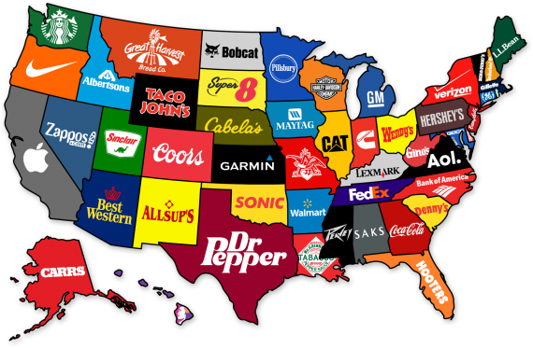
Corporate Image
http://plusblog.jp/8357/

Slide 6
Corporate Image
Studied in the last 50 years
More than $9 billion/year in US
40-60% of US companies use corporate image advertizing
Corporate image impact on product evaluations by consumers
Higher the product/service risk, consumers tend to search for more information
Z Gürhan-Canli, R Batra. 2004. When corporate image affects product evaluations: the moderating role of perceived risk. Journal of Marketing Research. 41(2): 197-205.

Slide 7
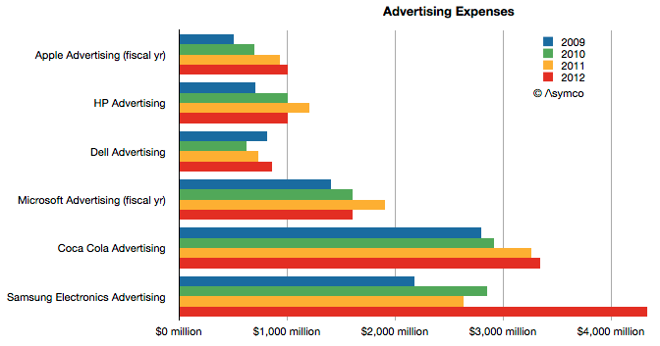
Corporate Image
Advertising Expenses
http://www.asymco.com/2013/04/02/the-cost-of-selling-galaxies-updated/

Slide 8



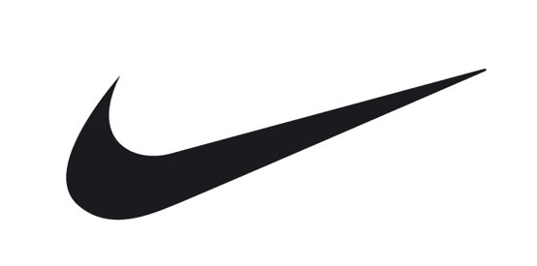


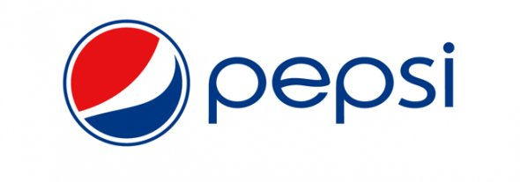


Corporate Image
How much to spend in a logo?
$0
$0
$0
$15
$35
$33,000
$1 million
$1.8 million
$100 million

Slide 9
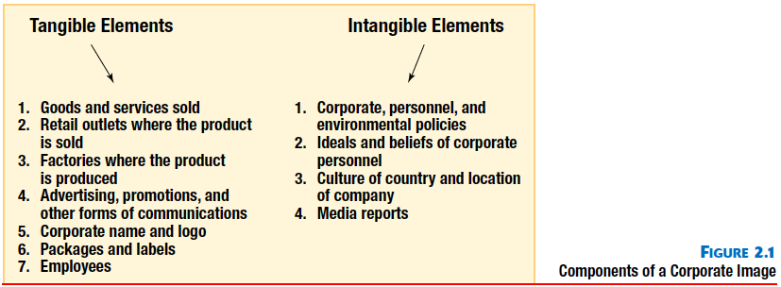
Corporate Image
Components of CI
Clow, K., and Baack, D. 2007. Integrated Advertising, Promotion, and Marketing Communications. 3rd ed. Prentice Hall.

Slide 10
Corporate Image
The role of CI (consumer perspective):
  Providing assurance regarding purchase decisions of familiar products in unfamiliar settings
  Giving assurance about the purchase when the buyer has little or no previous experience with the good or service
  Reducing search time in purchase decisions
  Providing psychological reinforcement and social acceptance of purchases
Clow, K., and Baack, D. 2007. Integrated Advertising, Promotion, and Marketing Communications. 3rd ed. Prentice Hall.

Slide 11
Corporate Brand
“In general, a corporate brand may be more likely to possess intangible attributes or organizational characteristics that span product classes than a product-brand whose associations are more likely to be product-specific.”
Keller, K. L., & Aaker, D. A. (1997). Managing the corporate brand: The effect of corporate marketing activity on consumer evaluations of brand extensions. Working Paper Report No. 97-106, May. Cambridge, MA: Marketing Science Institute

Slide 12
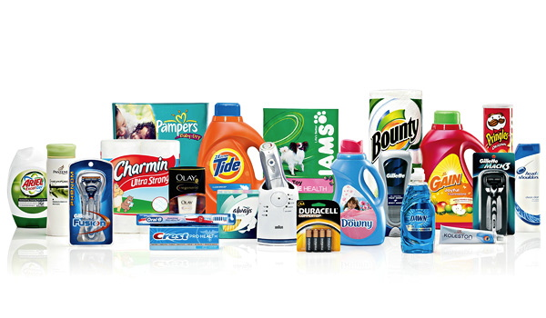
Corporate Brand
Procter and Gamble: Product brand
http://images.businessweek.com/ss/09/12/1210_best_internship_companies/5.htm

Slide 13
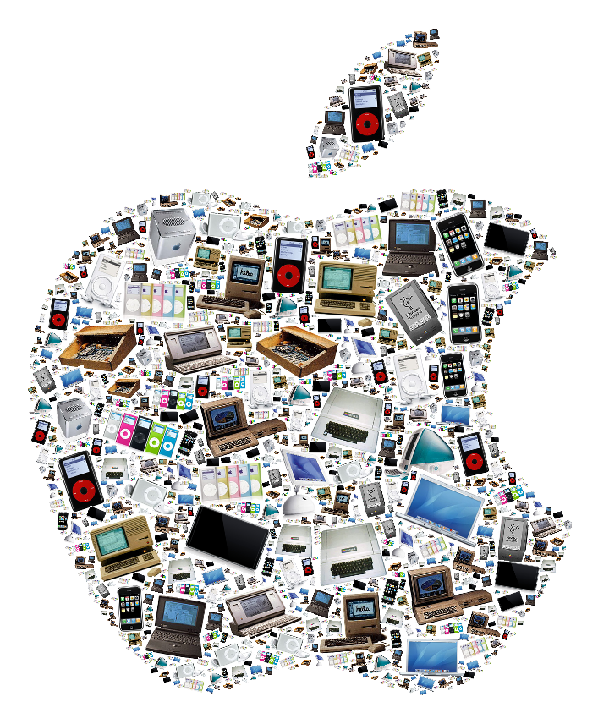
Corporate Brand
Apple:
Corporate brand
http://www.neoformix.com/2010/AppleLogoProducts.png

Slide 14








CI and Perceived Value
To be the world’s most customer-centric company
Making the best possible ice cream, in the nicest possible way
To make people happy
Worldwide leader in retail
A personal computer in every home running Microsoft software
To make it affordable and easy for women to be physically fit
To Create a Better Everyday Life for the Many
To organize the world's information and make it universally accessible and useful
People Fly for Free

Slide 15

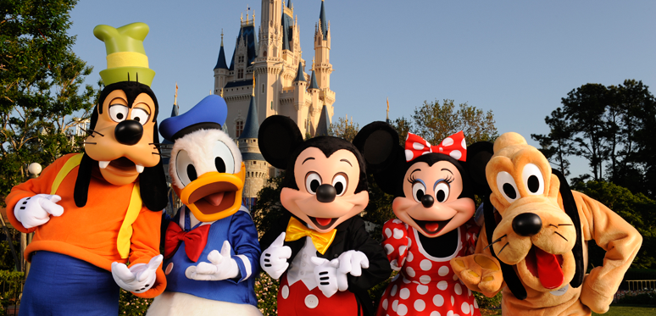
CI and Perceived Value
Greater value to customer increase customer loyalty
CI is linked to customer satisfaction levels

Slide 16
CI Associations
Innovativaness
Environmental Impact
Dynamism and imaginativeness
Quality of goods and services
Honesty and trustworthiness
Social responsability
Investment value
Quality of Management
Helpfulness and friendliness
Conservative vs. Informal corporate culture
Dowling, Grahame R. (1986), "Measuring Corporate Images: A Review of Alternative Approaches," Journal of Business Research, 17 (1), 27-34.

Slide 17
CI Associations
Most important CI associations:
  1. Quality of goods and services
  2. Honesty and trustworthiness (stand behind their product)
  3. Helpfulness and friendliness (dealing with customers)
Clow, K., and Baack, D. 2007. Integrated Advertising, Promotion, and Marketing Communications. 3rd ed. Prentice Hall.

Slide 18
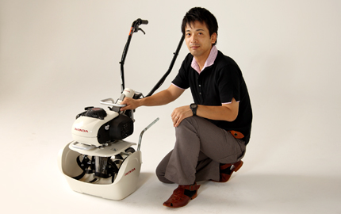
CI and Quality
Honda’s Pianta
http://world.honda.com/design/designers-talk/pianta/

Slide 19

CI and Honesty
Cenegenics: Testosterone to lasting youth?

Slide 20


CI and Helpfulness
Have an issue? Call and wait and wait…

Slide 21
CI and Innovation
Innovativaness and trustworthiness have great impact on consumer evaluations in purchasing decisions where a high level of risk is perceived
Z Gürhan-Canli, R Batra. 2004. When corporate image affects product evaluations: the moderating role of perceived risk. Journal of Marketing Research. 41(2): 197-205.

Slide 22
CI: Risks and New Markets
Risks of entering new markets or launching new products or services are quite substantial
Firms appeal to familiarity and prestige, or rather, the image of brands as a leverage for enhancing credibility and unobservable quality

Slide 23
CI: Risks and New Markets
Low risk products/services: cereal, soda, milk, taxi ride
  Little or no penalty for making the wrong decision
High risk products/services: solar panels, electric car, stocks, building contractor, new computer, doctor, attorney
  Objective information from reliable sources

Slide 24
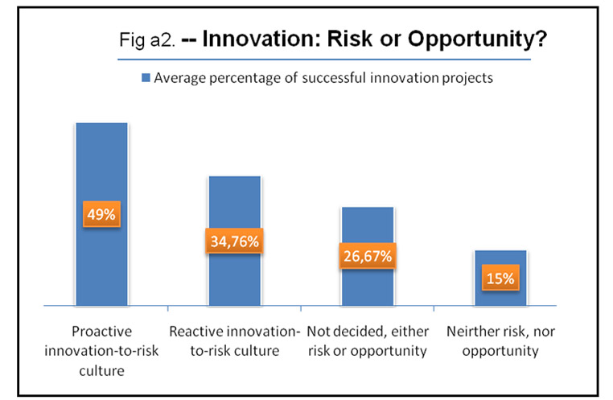
CI: Risks and New Markets
http://www.innovationmanagement.se

Slide 25
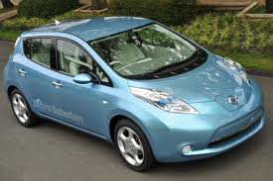
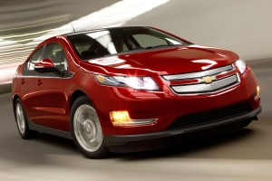
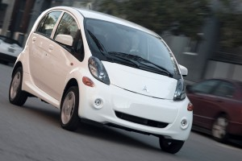
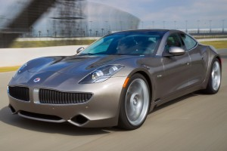
CI and Trustworthiness
Risky investment, an electric car

Slide 26
CI and Innovation
“Innovation is risky business. It starts with an idea from an individual inside the company. The fragile idea will run into so many hardships from within the company let alone technical difficulties. It is unfortunate, but it is natural”
How to bridge ideas into commercial products?
Research and Development
Commercialization
Ozcanli, O, 2013. Innovation in Large Companies. Forbes.

Slide 27
CI and Innovation
The implementation of a new or significantly improved:
Innovation
New or significantly improved product
New organizational method in business practices
New marketing method
New process
Idea generation
Drivers
*Organization for Economic Co-Operation and Development (OECD). (2005). Oslo Manual: Guidelines For Collecting And Interpreting Innovation Data. 3rd edition. A joint publication of OECD and EuroStat.

Slide 28
CI and Innovation
Innovation technological sources*
Science-based firms
Supplier-based firms
Engineered wood products
Adhesives, biofuel
Software developers
Equipment developers
Sawmills
Veneer
Furniture
Flooring
Internal Activities
External Activities
R&D for new product development
Two internal technological capabilities
  Expenditures on R&D process
  Expenditures on Training
Purchased Knowledge
  Patents, machinery, outsourced R&D
Cooperative knowledge
  Universities, Industrial agents
*Vega-Jurado, J., Gutiérrez-Gracia, A., and Fernández-de-Lucio, I. (2008). How do Spanish firms innovate? An empirical evidence. Journal of Technology Management and Innovation. 3(1): 100-111.

Slide 29

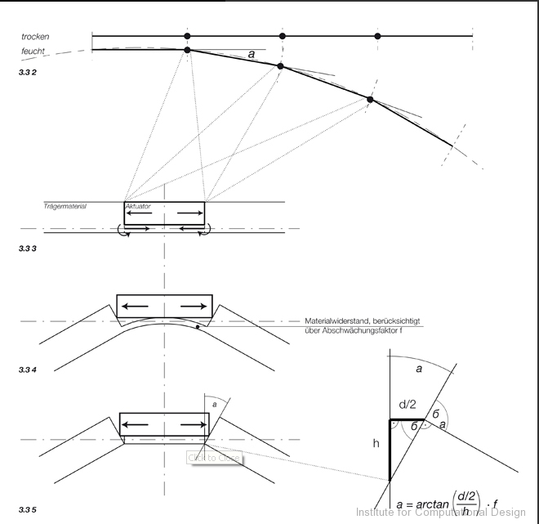
CI and Innovation
Hygroscopic actuators
* Menges, A. 2011. Hygroscopic Actuators. Available at http://www.achimmenges.net

Slide 30
CI and Innovation
Shorter life cycles
Some strategies to extend life cycles
  Additional features: Apps for Iphones or Ipads
  Office furniture maintenance programs
Maturity
Growth
Volume
Decline
Introduction
Time

Slide 31
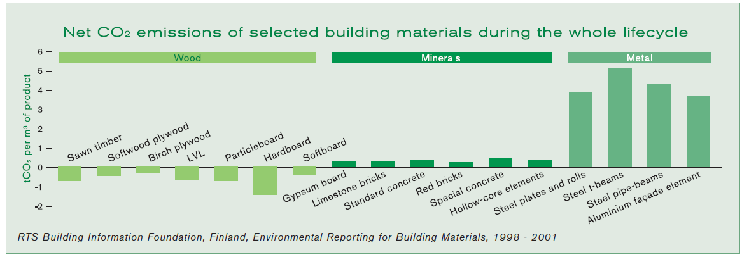
CI and Environmental Impact
Environmental impact of construction materials
* RTS Building Information Foundation. Environmental Reporting for Building Materials 1998-2001.

Slide 32
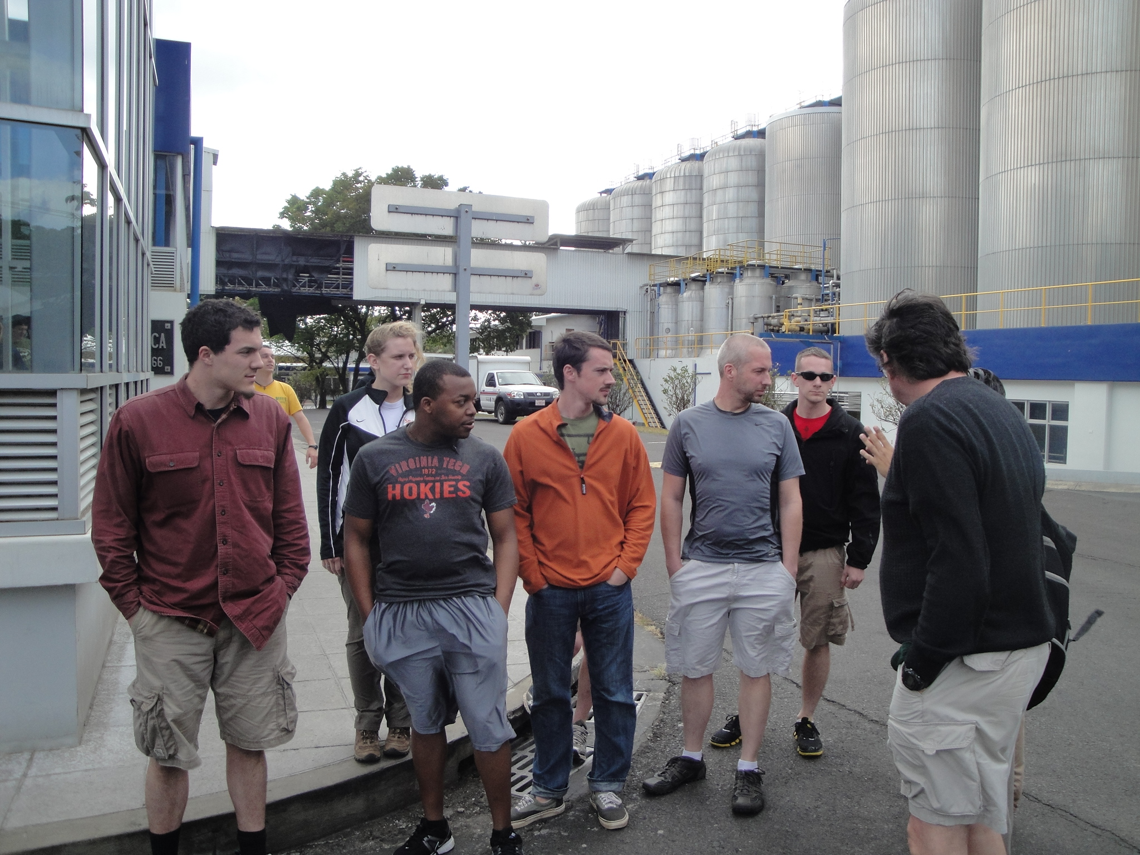
CI and Environmental Impact
“When I joined the company,” explained Ramón Mendiola Sánchez, Chief Executive Officer of Florida Ice & Farm, “we were at 12 litres of water for every litre we produced. We’re now at 4.9 litres in 2011 – we’re very proud of that, and our goal is to go to 3.5 litres.”
* Word Economic Forum. 2011. Redefining the Future of Growth: The New Sustainability Champions.

Slide 33

CI and Environmental Impact

Slide 34
CI and Social Responsability
Forbes top 5 firms in terms of CSR:
  Microsoft
  Google
  Disney
  BMW
  Apple
Study found that 42% of how people feel about a company is based on their perceptions
of the firm’s corporate social responsability (CSR)
Forbes. 2013. The 10 Companies with the best CSR Reputations. Available at http://www.forbes.com/pictures/efkk45mmlm/the-10-companies-with-the-best-csr-reputations/

Slide 35
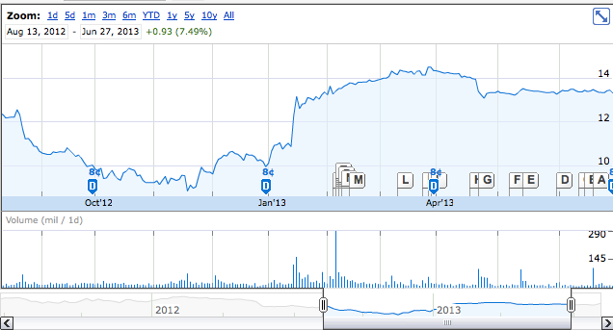
CI and Investment Value
Case of DELL, current issues
  Shrinking PC market
  Rapidly growing long-term debt
  Accounting issues
But big opportunities arose for investors:
  Transition from PC manufacturing to IT services
  International growth
  Focus on R&D
  Strong global market position
  Dividens payout
  Expansion to financial services to Europe and Canada
Currenty DELL stocks is 27.8% higher than what it was in 2012

Slide 36
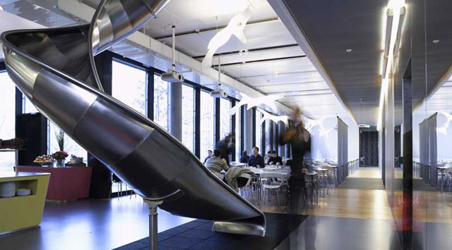
CI and Corporate Culture
Informal culture: khakis, jeans, and flip-flops
Provide a confortable and fun working environment
Awesome amenities: gym memberships, dry cleaning, on-site chefs
Top ranked
  Google, Zappos, Facebook, Electronic Arts, Twitter, LinkedIn, Quicken Loans, AOL, Genetech, and Apple
http://www.businessinsurance.org/10-big-businesses-with-incredibly-casual-offices/

Slide 37
Managerial Implications
What is the company doing now?
Identify current strategy
Identify assumptions
1
2
What is happening in the environment?
Identify key factors for success and failure
Identify capabilities and limitations of competitors
Identify government and societal changes
Identify company strenghts and weakness related to competitors
3
What should the company do next?
Compare present strategy to environmental situation
Identify alternative courses of action
Choose best alternative
Michael Porter, Competitive strategy

Slide 38
Managerial Implications
Developing a strong brand name: What is the one thing that stands out your company apart?
  Coca Cola, refreshing
  Volvo, safety
  Crest, cavity protection
  BMW, performance driving
  Walmart,?
  Apple,?
  American Airlines,?

Slide 39
Managerial Implications
Build corporate image on the innovation and thrustworthiness dimensions when products are more risky
Highly innovative and thrustworthed firms could turn consumer’s level of perception on high risk products into a legally or ethically good possibility
Z Gürhan-Canli, R Batra. 2004. When corporate image affects product evaluations: the moderating role of perceived risk. Journal of Marketing Research. 41(2): 197-205.

Slide 40
Managerial Implications
Brand extensions are increasingly recognized as a strategic asset by many companies
Green product/process innovation are positively associated with corporate competitive advantage
Sometimes “it may pay to wait” (innovate late movers)

Slide 41

Thank you!
Henry Quesada
quesada@vt.edu

